Slide 1




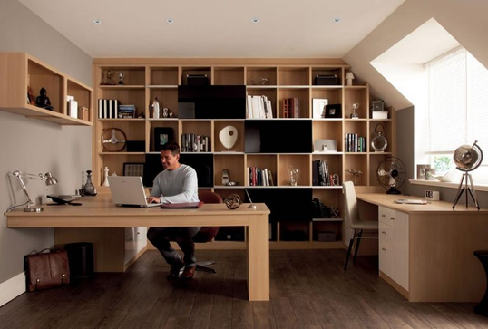
Question 1
A
department head
C
Team Leader
B
D
director
department

Slide 2
Question 1
A
department head
C
Team Leader
B
D
director
department

Slide 3
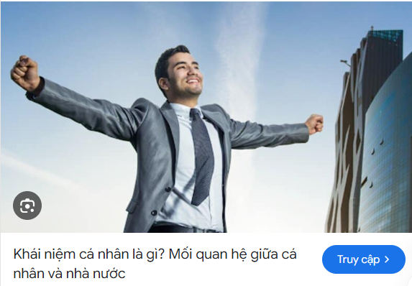

Question 3
A
personal business
C
advertisement
B
D
wide business
business

